Slide 1

Welcome
Introduction to Terraform
Notes:
Mandatory
ACTION: Adjust title to fit your course.

Slide 2
Prerequisites
This course assumes you
Are familiar with AWS
Can navigate directories and create files in the command line
Please Note
If you’re not comfortable on bash, cmd or powershell, or have never worked in AWS before, this might not be the right class for you.
Please chat me so we can get you to the right resource.
Notes:
Mandatory
ACTION: Adjust prerequisites to fit your course. Keep it brief.
Script: Before we start, I want to make sure everyone is in the correct class. Take a look at these prerequisites and message me in Chat if you have questions or aren’t sure you’re in the right spot.

Slide 3

































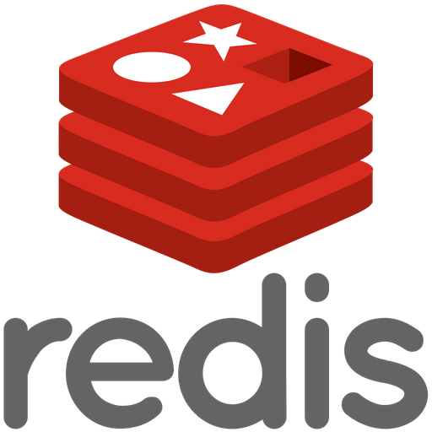




We teach over 400 technology topics
Notes:
Mandatory
Script: DevelopIntelligence teaches a lot of different tech. If there’s a technology you want to learn and you don’t see it in your company’s learning catalog, let your manager know. We’d be glad to help.”

Slide 4



You experience our impact on a daily basis!
Notes:
Mandatory
Script: In your everyday life, you come across tech many times a day. When you shop online. When you pay for your morning coffee. When you watch a movie or travel. We train software developers and IT professionals who work on many of the products and services you use daily.
In fact, when you talk on the phone, watch a movie, connect with friends on social media, drive a car, fly on a plane, shop online, and order a latte with your mobile app, you are experiencing the impact of our solutions.

Slide 5



Note About Virtual Trainings
What we want
...what we’ve got

Slide 6



Virtual Training Expectations for You
Arrive on time
Mute unless
speaking
Use chat or
raise hand

Slide 7
My pledge to you
I will...
Make this interactive
Ask you questions
Ensure everyone can speak
Create an inclusive learning environment
Use an on-screen timer for breaks
…also, if you have an accessibility need, please let me know
Notes:
Mandatory
Script: This is my pledge to you. I’d like to talk in particular about the third bullet. Sometimes in a class, an enthusiastic participant will want to speak out in every discussion, answer every question and so forth. I want to make sure all of you have the opportunity to be heard. So, if I haven’t heard from you in awhile, I may call on you or check in via chat, because I want to make sure everyone gets their questions answered. Also, I want to demonstrate the timer and confirm that everyone can see it. EggTimer is a good timer - https://e.ggtimer.com/

Slide 8
Objectives
At the end of this course you will be able to:
Read and write Terraform code
Utilize reusable Terraform patterns
Understand Infrastructure as Code best practices
Notes:
Mandatory
ACTION: Adjust objectives to fit your course.
Use measurable objectives that start with action verbs such as: describe, define, identify, assess, demonstrate, use, utilize. https://elearningindustry.com/writing-learning-objectives-for-elearning-what-elearning-professionals-should-know

Slide 9
Schedule
Course runs 9:00am – 4:00pm Pacific time
Lunch break from 12-1 Pacific time
10-15 min. breaks as needed
Notes:
Mandatory
ACTION: Adjust agenda as per your course.
The agenda provides students a roadmap of where the class is going and what is coming up. Keep it high level, as there is no need to include “Gazornin” in the agenda if that’s something they don’t understand. Refer to the agenda at the beginning of the class, at the end of every day and at the beginning of every morning. In the mornings, the Agenda is a great way to facilitate a Q&A session about what was covered on the previous day.

Slide 10
Day 1 Agenda
Introduction to Terraform
Hashicorp Configuration Language (HCL)
Commands and the CLI
Variables, Locals and Data Sources
Provisioners
Backends and State
Providers
Workspaces
Outputs
Modules
Notes:
Mandatory
ACTION: Adjust agenda as per your course.
The agenda provides students a roadmap of where the class is going and what is coming up. Keep it high level, as there is no need to include “Gazornin” in the agenda if that’s something they don’t understand. Refer to the agenda at the beginning of the class, at the end of every day and at the beginning of every morning. In the mornings, the Agenda is a great way to facilitate a Q&A session about what was covered on the previous day.

Slide 11
Day 2 Agenda
Troubleshooting, Errors and Debugging
Expressions
Functions
Data Types and Conditionals
Meta-Arguments
Backends (Part 2)
Terraform Cloud/Enterprise
Sentinel
Notes:
Mandatory
ACTION: Adjust agenda as per your course.
The agenda provides students a roadmap of where the class is going and what is coming up. Keep it high level, as there is no need to include “Gazornin” in the agenda if that’s something they don’t understand. Refer to the agenda at the beginning of the class, at the end of every day and at the beginning of every morning. In the mornings, the Agenda is a great way to facilitate a Q&A session about what was covered on the previous day.

Slide 12
How we’re going to work together
Slides and Exercises in this GitHub Repository:
https://github.com/devbyaccident/Introduction-to-Terraform
Exercises-Only in this repository:
https://github.com/devbyaccident/terraform-workshop
Everyone should have an email from me with login instructions to AWS
We’ll be setting up a Cloud9 workspace shortly
Notes:
Mandatory
ACTION: Adjust bullets as per your course.
In this section, discuss the structure of the course—exercises, labs, etc.
Also, discuss any resources students will be using.

Slide 13

Student Introductions
Name and job title?
Where are you based?
What do you hope to get out of this course?
Fun fact?
Your name?
and preferred pronouns?
Notes:
Optional, because you may already plan to do this in your own materials…
ACTION: We want to be sure you take time to have the students introduce themselves. It could happen here, or it could happen at the start of your materials.

Slide 14
Hello...
About me...
DevOps Engineer @ CHOP
Pluralsight Author
Based out of Philadelphia PA
Loves watching old Kung-Fu movies
Chris Blackden
(He, Him, His)
with DevelopIntelligence, a Pluralsight Company.
Notes:
Mandatory
ACTION: Adjust to fit you.
Script: I am [insert name] with DevelopIntelligence. We’re the training partner for [insert client name]. [Provide brief info on your background.]
Wing it!!! Keep it short!!! (Under 2 minutes; less than 1 is even better). Your goal is to establish rapport. You’re just trying to connect with the students. For example...
Here’s a little about my background in case you want this for reference later. Fun fact: [insert a piece of trivia about your personal life…”When I’m not teaching or coding, I am a skydiver”…whatever cool hobby you are engaged in]
Avoid putting your resume here. Say only a sentence or two about your professional credentials and invite them to ask questions about your background or experiences at any point during the training.

Slide 15
Why study Terraform?
Very robust Infrastructure-as-Code tool
Multi-Cloud
Open-Source
Huge community
Notes:
Mandatory
ACTION: Adjust benefits to fit your course.
Examples...
You’ll be learning Python so that you can work on XYZ project…

Slide 16
Some Notes about Terraform
Terraform released version v1.0 in June 2021
Backwards Compatible with v0.15.5 and up
https://www.hashicorp.com/blog/announcing-hashicorp-terraform-1-0-general-availability
You will be spending a lot of time in the docs
https://www.terraform.io/docs/
There is a certification path
https://www.hashicorp.com/certification#hashicorp-certified-terraform-associate

Slide 17
Other Good Sources for Learning
Terraform has been around a while now, and is pretty popular, so there are plenty of other sources for learning
Hashicorp’s learning portal: https://learn.hashicorp.com/terraform
Terraform Github repository: https://github.com/hashicorp/terraform/
Terraform courses on Pluralsight: https://app.pluralsight.com/paths/skill/managing-infrastructure-with-terraform

Slide 18
What is Terraform?
Infrastructure as Code (IaC)
Declarative domain-specific language
What is declarative?
Used to describe idempotent resource configurations
According to Hashicorp:
Terraform enables you to safely and predictably create, change, and improve infrastructure. It is an open source tool that codifies APIs into declarative configuration files that can be shared amongst team members, treated as code, edited, reviewed, and versioned
Notes:
Infrastructure as Code (IaC)
Declarative domain-specific language
What is declarative?
Used to describe idempotent resource configurations
According to Hashicorp:
Terraform enables you to safely and predictably create, change, and improve infrastructure. It is an open source tool that codifies APIs into declarative configuration files that can be shared amongst team members, treated as code, edited, reviewed, and versioned

Slide 19
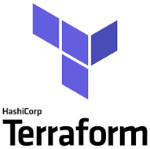
What is Terraform? (cont’d)
Open source CLI tool for infrastructure automation
Utilizes plugin architecture
Extensible to any environment, tool, or framework and works primarily by making API calls to those environments, tools, or frameworks
Detects implicit dependencies between resources and automatically creates a dependency graph
Builds in dependency order and automatically performs activities in parallel where possible
...sequentially for dependent resources

Slide 20
Why Use Terraform?
Readable
Repeatable
Certainty (i.e., no confusion about what will happen)
Standardized environments
Provision quickly
Disaster recovery

Slide 21
What Does Terraform (HCL) Look Like?
resource “aws_instance” “web” {
ami = “ami-19827362728”
instance_type = “t2.micro”
tags = {
Name = “my-first-instance”
}
}

Slide 22
Exercise Prep: Let’s Get Set Up
We will create an isolated (and consistent) development and execution environment where you can run Terraform
You have been emailed your student alias, access key, secret key, and console password (check your Junk folder if you don’t have an email from me, and I can also send you the info via Zoom Chat)
Let’s get these working in your development environment–this will allow you to create things and verify they exist in AWS
Access to your instructional repository: Course Setup

Slide 23

Format of a Terraform Project
example-terraform-project
.terraform (more on this directory later)
main.tf
outputs.tf
variables.tf
terraform.tfvars
others.auto.tfvars
*.tf files get merged at runtime
terraform.tfvars and *.auto.tfvars files get merged at runtime

Slide 24
Hashicorp Configuration Language (HCL)
The goal of HCL is to build a structured configuration language that is both human and machine friendly for use with command-line tools, but specifically targeted towards DevOps tools, servers, etc.
Fully JSON compatible
Made up of blocks, which roughly equate to JSON objects. Each block maps to an object type as defined by Terraform providers (we’ll talk more about providers later)
https://github.com/hashicorp/hcl

Slide 25
Terraform Project Content Types
*.tf, *.tf.json
HCL or JSON
These files define your declarative infrastructure and resources
*.tfstate
JSON files that store state, reference to resources
Created and maintained by terraform
*.tfvars, *.tfvars.json, *.auto.tfvars, *.auto.tfvars.json
HCL or JSON
Variable definitions in bulk
(More to come on setting variable values at runtime)

Slide 26
Resources
*.tf files contain your HCL declarative definitions
Most blocks in your HCL represent a resource to be created/maintained by Terraform
resource “aws_instance” “web” {
ami = “ami-19827362728”
instance_type = “t2.micro”
tags {
Name = “my-first-instance”
}
}

Slide 27
Resources
Resources are key elements and captured as top-level objects (blocks) in Terraform configuration files
Each resource block indicates the intent to idempotently create that resource
Body of resource contains configuration of attributes of that resource
Each provider (e.g., AWS, Azure, etc.) provides its own set of resources and defines the configuration attributes
When a resource is created by Terraform, it’s tracked in Terraform state

Slide 28
Terraform Commands and the CLI
The CLI is how you’ll most often use terraform
terraform init …
terraform plan …
terraform apply …
And plenty more: terraform --help or https://www.terraform.io/docs/commands/index.html
Third-party SDKs also available for running and interacting with Terraform (e.g., scalr)

Slide 29
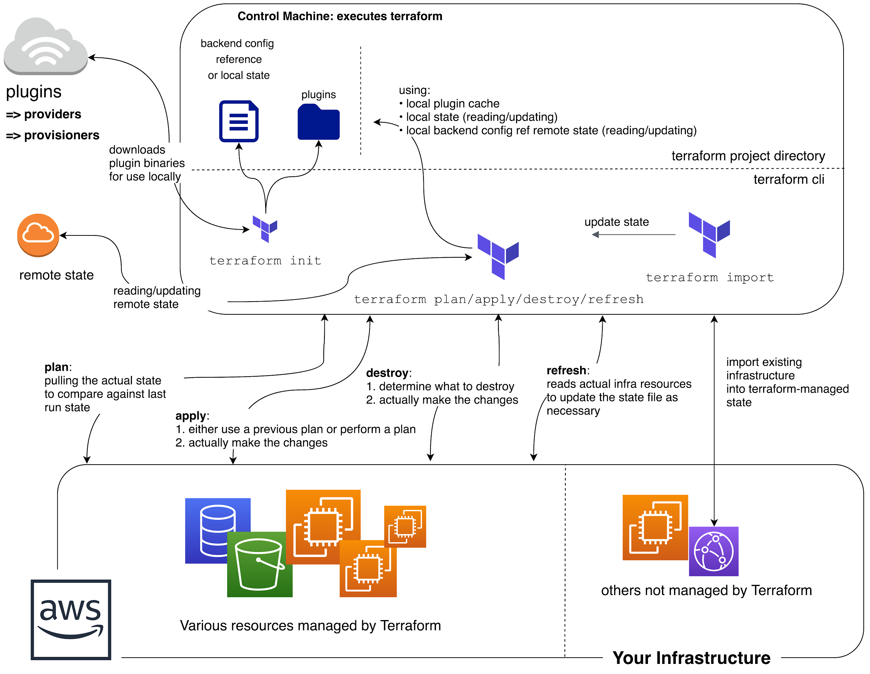
Big picture look at
Terraform Command Flow

Slide 30
terraform init
A special command, run before other commands/operations
What does it do?
Downloads required provider packages, modules
Initializes state
Local state: ensuring local state file(s) exist
Remote state: more complex initialization (more on remote state later)
Basic syntax check
Idempotent
Remember the .terraform directory?
The init command downloads the provider packages and modules to this directory
Also where state files live.

Slide 31
Exercise 1: First Terraform Project
Exercise 1

Slide 32
Extending Your Project
Input Variables
Locals
Data Sources
Provisioners
remote-exec
local-exec
null_resource

Slide 33
Input Variables
Enable interchangeable values to be stored centrally and referenced single or multiple times
Similar to variables in other languages
Declared in variable blocks
Parsed first
Cannot interpolate or reference other variables
Allow for default values
Optionally specify value type, e.g.,
List, Map, String

Slide 34
Example Variable Definition
variable “instance_size” {
default = “t2.micro”
type = string
description = “Size of EC2 instance”
}

Slide 35
Locals
Mutable values that allow for interpolation and inference
CAN reference variables and other locals
CAN’T be set via arguments from the command line
Use them when a value is used in many places in your code and that value is likely to change
Don’t overuse them or your code can be difficult to read

Slide 36
Local Definitions
locals {
one = “1”
local_one = local.one
concat_one = “${local.one}_and_one”
}

Slide 37
Data Sources
Logical references to data objects stored externally to the tfstate file
Allows you to reference resources not created by Terraform
Examples
Current default region in AWS CLI
AMI ID search
AWS ARN lookup
AWS VPC CIDR range
Notes:
AMI = Amazon Machine Image
ARN = Amazon Resource Name
CIDR = Classless Internet Domain Routing

Slide 38
Data Source Example: AWS AMI Lookup
data "aws_ami" "latest-ubuntu" {
most_recent = true
owners = ["099720109477"]
filter {
name = "name"
values = ["ubuntu/images/hvm-ssd/ubuntu-xenial-16.04-amd64-server-*"]
}
filter {
name = "virtualization-type"
values = ["hvm"]
}
}
Notes:
HVM = hardware virtual machine (cf. xen)

Slide 39
Provisioners
Allow you to run commands during instance provisioning that are run on create, recreate, or taint correction (explained later), but not every time terraform apply is run
Ties custom logic to idempotent resources
Types
local
remote
Connectors
SSH
WinRM
Notes:
WinRM = Window Remote Management

Slide 40
Provisioner Example: local-exec
resource “aws_instance” “web” {
ami = “ami-19827362728”
instance_type = “t2.micro”
tags {
Name = “my-first-instance”
}
provisioner “local-exec” {
command = “echo ‘created instance’”
}
}

Slide 41
Provisioner Example: remote-exec
resource “aws_instance” “web” {
...
provisioner “remote-exec” {
inline = ["sudo sed -i
's/^PasswordAuthentication.*/PasswordAuthentication yes/' /etc/ssh/sshd_config",
"sudo service sshd restart",
"wget https://repo.anaconda.com/Anaconda3-Linux-x86_64.sh",
"sh Anaconda3-Linux-x86_64.sh -b"]
}
}

Slide 42
Provisioner example: null_resource
resource “null_resource” “first-tf-run” {
provisioner “local-exec” {
command = “echo ‘this will run on first tf apply’”
}
}
Notes:
Ask students–Why only on first run?

Slide 43
Exercise 2: Using Variables
Exercise 2

Slide 44
How Terraform Works
State and how to query it
Computing plans
Executing plans (terraform apply)

Slide 45
Executing Plans: terraform apply
What does terraform apply do?
Syntax check
Check for init
Refresh state
Execute plan
Ask for input
Execute changes

Slide 46
State
Stores information about resources that are created by Terraform
Also includes values computed by the provider APIs
Local file
.tfstate
Or backends are also available…

Slide 47
Exercise 3: Plans and Applies
Exercise 3

Slide 48
Backends
Determines how state is loaded and how operations like apply are executed
Enables non-local file state storage, remote execution, etc.
Why use a backend?
Can store the state remotely
Some backends, e.g., Terraform Cloud automatically store all revisions
Keep sensitive information off local disk
Remote operations
Apply can take a LONG time for large infrastructures
Notes:
Swift = objecy/blob store

Slide 49
Backends (cont’d)
Examples
S3
Azurerm
GCS
pg (Postgresql)
Hashicorp Consul
Terraform Cloud
Terraform Enterprise
etc.
Notes:
Swift = objecy/blob store

Slide 50
How to Query or See the Current State
CLI
terraform show [-json]
https://www.terraform.io/docs/commands/show.html
Remote State Data Type
https://www.terraform.io/docs/providers/terraform/d/remote_state.html

Slide 51
Exercise 4: Querying State
Exercise 4

Slide 52
Providers
Responsible for understanding API interactions and exposing resources
Declared as a provider blocks in HCL
Each Terraform project can have multiple providers
Three different tiers of providers:
Official (Ex: AWS, Azure, GCP, etc)
Verified (Pagerduty, Okta, Github, etc)
Community
Provider documentation
https://www.terraform.io/docs/providers/aws/index.html

Slide 53
Configuring the Provider
provider “aws” {
region = “us-east-1”
access_key = “[your access key]”
secret_key = “[your secret access key]”
}

Slide 54
Exercise 5: Interacting with Providers
Exercise 5

Slide 55
Reuse Patterns in Terraform
Workspaces: Separate state files for the same HCL
Outputs: Automated use of terraform-managed resources
Modules: Packaged HCL for reuse

Slide 56
Workspaces
Workspaces allow you to use the same configuration (HCL/project) for multiple states
Example: Environments: Each environment, (DEV, PROD, etc) has it’s own state and resources, but the same HCL code
Nothing more than separately-named state files
Both local and remote state backends support workspaces

Slide 57
Outputs
Inputs to Terraform config are declared with variable blocks
Outputs are declared with a special output block
Can be referenced through the modules interface or the CLI

Slide 58
Output Definition
output “instance_public_ip” {
value = aws_instance.web.public_ip
}

Slide 59
Modules
Modules are a critically important concept in Terraform
Modules allow for consistent creation of resources with the exact same configuration
Resources can be re-deployed after changing module code to fix infrastructure bugs

Slide 60
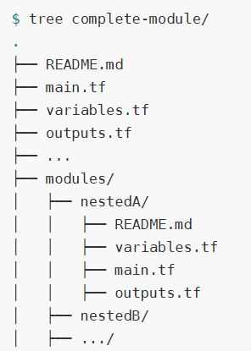
Modules
Any project can contain one or more modules
Parent module can reference nested modules
Modules can be defined in the local filesystem or remote source (Github, terraform registry, etc…)

Slide 61
Modules
Publish modules in Terraform registry to make them easy to find
Source attribute identifies location of module, e.g.,
Most attributes of a module are input variables passed in from parent
Module’s outputs can be accessed and used by parent (and passed to other child modules of the parent)

Slide 62
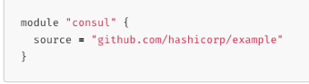
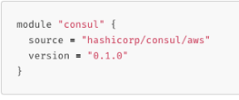
Module Sources
Terraform allows the user to pull modules from various locations
Local paths
Github
Terraform Registry
Bitbucket
HTTP
S3 Buckets
More info
https://www.terraform.io/docs/modules/sources.html

Slide 63
Module Example
variable “thing” {
type = string
}
resource null_resource “null” {
provisioner local-exec {
command = "echo ${var.thing}"
}
}

Slide 64
Using the Module
module “my_module” “printer” {
source = “./my_module”
# this is a variable passed into module
thing = “this should be printed”
}

Slide 65
Exercise 6: Modules
Exercise 6

Slide 66
Experimentation Time: Webserver
Let’s first do this by hand, then use Terraform
Create an EC2 instance, type t2.micro, whatever distro you like
Provision this instance to install nginx
Make sure we can access nginx from the outside world
Getting help
Use online docs for help
Ask questions in the chat!

Slide 67
Experimentation Time: Webserver (cont’d)
You can go in many different directions as you solve this, and there are plenty of things to play with along the way and after, some ideas:
Imagine your Terraform code to spin up this instance needed to be reused, what are your options–make it reusable!
Pretend that some other automation needed the public IP from the created instance, how would you do this?
...And finally, ANYTHING else you’d like to start learning more about, terraform graph maybe?
Notes:
Hints: Workspaces, package as a module
Hints: Outputs, wrap Terraform Commands in bash scripts, etc..

Slide 68
Welcome to Day 2!
Introduction to Terraform
Notes:
Mandatory
ACTION: Adjust title to fit your course.

Slide 69
Day 1 Recap and Review
Let’s discuss some takeaways from yesterday
What questions do you have after sleeping on it?
Corrections, omissions
OK, let’s get into it

Slide 70
Error Handling and Debugging
Most errors fall into one of four types
Process Errors
Syntax Errors
Validation Errors
Passthrough Errors

Slide 71
Process Errors
Errors due to process not being followed
e.g.,
Running apply before init
Variables not fully populated

Slide 72
Syntax Errors
Caused by an error in syntax, e.g.,
HCL codebase syntax or parameter errors
Incorrect usage of built in functions
Type errors

Slide 73
Validation Errors
Preliminary validation built into provider occurring before plan
Usually more detailed

Slide 74
Provider Errors / Passthrough
Errors received from provider or third party API while in process of refresh, plan, apply, etc.
Usually most difficult to troubleshoot
Requires knowledge of provider’s tech (e.g., AWS)

Slide 75
Troubleshooting Commands
terraform validate
Performs a syntax check on all terraform files in the directory
Displays an error if any of the files doesn't validate
Does NOT check formatting
What does it check…?

Slide 76
terraform validate
Invalid HCL syntax (e.g., missing quote or equal sign)
Invalid HCL references (e.g., variable name or attribute which doesn't exist)
Same provider/module/resource declared multiple times
Invalid module name
Interpolation used in places where it's unsupported (e.g., variable, depends_on, module.source, provider)
Missing value for a variable (none of -var foo=... flag, -var-file=foo.vars flag, TF_VAR_foo environment variable, terraform.tfvars, or default value in the configuration)
Notes:
depends_on = if Terraform must manage access control policies and take actions that require those policies to be present, there is a hidden dependency between the access policy and a resource whose creation depends on it. In these rare cases, the depends_on meta-argument can explicitly specify a dependency.

Slide 77
Troubleshooting: terraform fmt
Rewrites Terraform files in a canonical format/style
By default, scans the current directory for configuration files
If the dir argument is provided then it will scan that given directory instead
If dir is a single dash (-) then fmt will read from standard input
Use the -recursive flag to format all .tf files in nested directories

Slide 78
Troubleshooting: terraform graph
Generates a visual representation of either a configuration or execution plan
Output is in DOT format, which can be used by GraphViz to generate charts: https://www.terraform.io/docs/internals/graph.html
e.g.,
terraform graph | dot -Tsvg > graph.svg

Slide 79
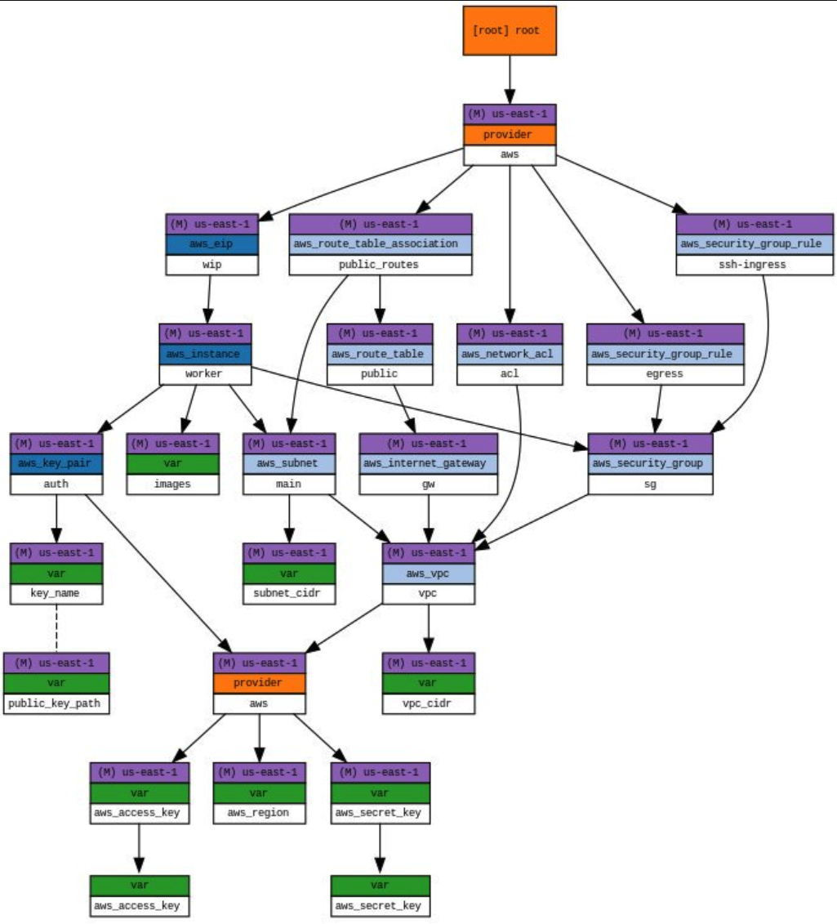
Visualizing Graph Outputs

Slide 80
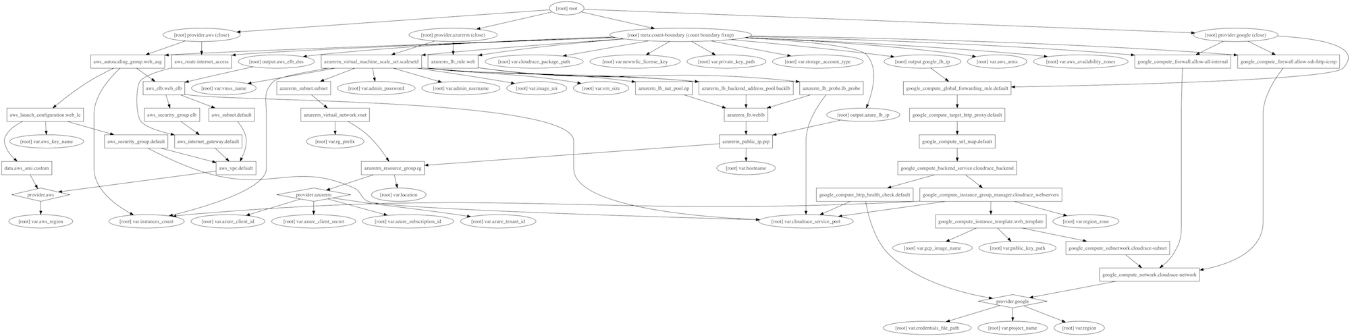
Visualizing Graph Outputs

Slide 81
Troubleshooting: terraform console
Creates an interactive console for testing interpolations
Similar to running the Python interpreter in interactive mode
Great for testing complex conditionals

Slide 82
Exercise 7: Error Handling, Troubleshooting
Exercise 7

Slide 83
Built-in Functions
Built-in functions:
Terraform ships with built-in functions
Called with the syntax name(arg, arg2, ...)
e.g., to read a file:
file("path.txt")
https://www.terraform.io/docs/language/functions/index.html

Slide 84
Conditionals
Interpolations may contain conditionals to branch on the final value
Syntax
CONDITION ? TRUEVAL : FALSEVAL

Slide 85
Primitive Data Types
String
Use the var prefix followed by the variable name
e.g., var.foo is how you would use the variable in HCL for interpolation or reference
Number
Can be referenced as a number, so in arithmetic for example
${var.foo + 1}
Bool
Can be referenced as a boolean in logic, so something like
var.foo == true ? “foo is true” : “foo is false”

Slide 86
Extended Data Types
List(<type>)
Ordered list of things, i.e., array
You can also return list elements by index: var.subnets[0]
Set(<type>)
Similar to a list, but: requires a type, unique values, no ordering
Map(<type>)
A collection of values where each is identified by a string
e.g., var.amis["us-east-1"] would get the value of the us-east-1 key within the amis map variable

Slide 87
Extended Data Types (cont’d)
Object({ <attr name> = <type>, … })
Like many other language object types, with properties containing other values
Tuple([<type>, …])
Very similar to a list, mixed strictly defined typed list of things

Slide 88
Count Parameter
Resources can be duplicated or conditionally created via the count parameter
resource “aws_instance” “web” {
count = 2
ami = var.ami
instance_type = var.instance_type
tags {
Name = “web-${count.index}”
}
}

Slide 89
Data Reference
Attributes of current resource
Syntax is self.ATTRIBUTE
e.g., self.private_ip interpolates resource's private IP address

Slide 90
Data Reference (cont’d)
Attributes of other resources
Syntax is TYPE.NAME.ATTRIBUTE
aws_instance.web.id
Interpolate ID attribute from the aws_instance resource web
If resource has a count attribute set, you can access individual attributes with a zero-based index, such as aws_instance.web.[0].id
Or use the splat syntax to get a list of all the attributes: aws_instance.web.[*].id

Slide 91
Data Sources and Reference
Attributes of a data source
data.TYPE.NAME.ATTRIBUTE
data.aws_ami.ubuntu.id
Interpolate id attribute from the aws_ami data source ubuntu
If data source has a count attribute set, access individual attributes with a zero-based index, e.g., data.aws_subnet.example[0].cidr_block
Or use the splat syntax to get a list of all the attributes: data.aws_subnet.example[*].cidr_block

Slide 92
Data Sources and Reference (cont’d)
Referencing values output from another module
module.MODULE_NAME.MODULE_OUTPUT_NAME

Slide 93
Resource Example w/Conditional
resource “aws_instance” “web” {
ami = var.ami
instance_type = var.instance_type
tags {
Name = var.env == “production” ? “production-web” : “staging-web”
}
}

Slide 94
Exercise 8: Understanding & Manipulating Data/Variables
Exercise 8

Slide 95
Keeping Terraform in Sync with Infra
Configuration drift
Things change!
Terraform can bring those things back in line naturally
plan
When executing a plan, Terraform can output machine readable syntax (exit codes) that can be used to monitor for manual infra changes
apply
Thanks to Terraform’s idempotency, corrections are natural and easy
Notes:
-detailed-exitcode

Slide 96
Keeping Terraform in Sync with Infra
What if we want to keep the changes?
You can import them
Use terraform import to pull in the changes to the state
Must also change the Terraform config to match any changes
If you have a clean plan with no planned changes, you were successful
e.g.,
terraform import aws_instance.my_instance i-abcd1234

Slide 97
Big picture look at
Terraform Command Flow

Slide 98
Expressions
Embedded within strings in Terraform, whether you're using the HCL or JSON, you can interpolate other values.
Allows you to reference variables, attributes of resources, call functions, etc.
Simple math like
${count.index + 1}
Allows for conditional statements
https://www.terraform.io/docs/language/expressions/index.html

Slide 99
Terraform Expressions
Can set attributes, outputs and locals to expressions
Expressions can refer to
Literal values or complex literal values: true, 13,“us-west1”,[1, 2],{a:1, b:2}
Resource or data source attributes: <RESOURCE TYPE>.<NAME>, data.<DATA TYPE>.<NAME>
Type indices: local.list[3], local.object.attrname, local.map["keyname"]
Variables: var.<NAME>
Locals: local.<NAME>
…

Slide 100
Terraform Expressions (cont’d)
Module outputs: module.<MODULE NAME>.<OUTPUT NAME>
Path variables: path.module, path.root, path.cwd
Workspace setting: terraform.workspace
Built-in functions using any of the above as arguments
max(5, 12, var.my_value)
Arithmetic, logical, or comparison operators combining the above
Conditional expressions: var.a != "" ? var.a : “default-a”
String template interpolation: “Hello, ${var.name}!”
String template directives:
"Hello, %{ if var.name != "" }${var.name}%{ else }unnamed%{ endif }!"

Slide 101
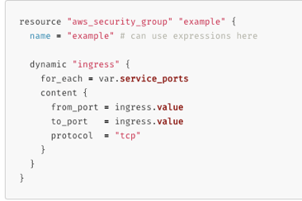
Terraform Expressions
dynamic blocks

Slide 102
Exercise 9: Resource Counts and Conditionals
Exercise 9

Slide 103
Terraform Meta-arguments
Resources, data sources, modules, and outputs can have meta-arguments (available across all types of all providers)
Modules have: source, version, providers
Outputs have: depends_on
Resources have: depends_on, count, for_each, provider, lifecycle, provisioner (provisioner can have connection inside)

Slide 104
Terraform Meta-arguments (cont’d)
Data sources have same as resources except for lifecycle
depends_on forces a dependency on another object even if no implicit dependency by referring to an attribute of another object
lifecycle controls how resources are modified when configuration changes
for_each is like count except it iterates over a set (unordered list) or map, has each.key, each.value instead of count.index to refer to each index

Slide 105
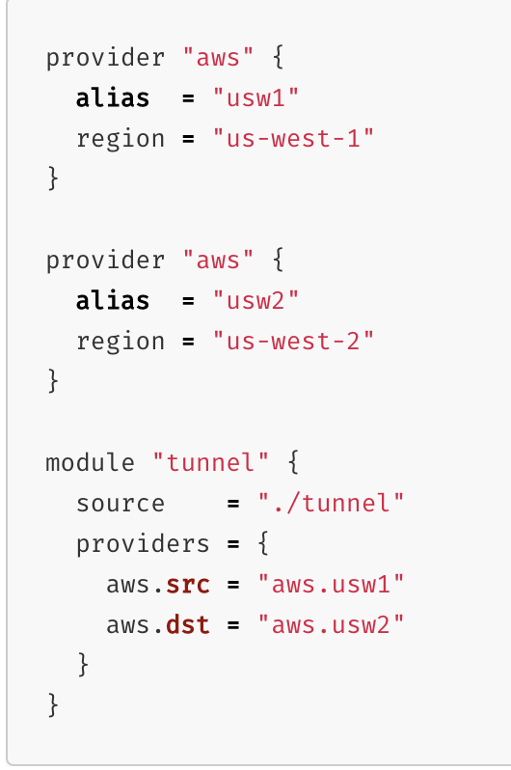
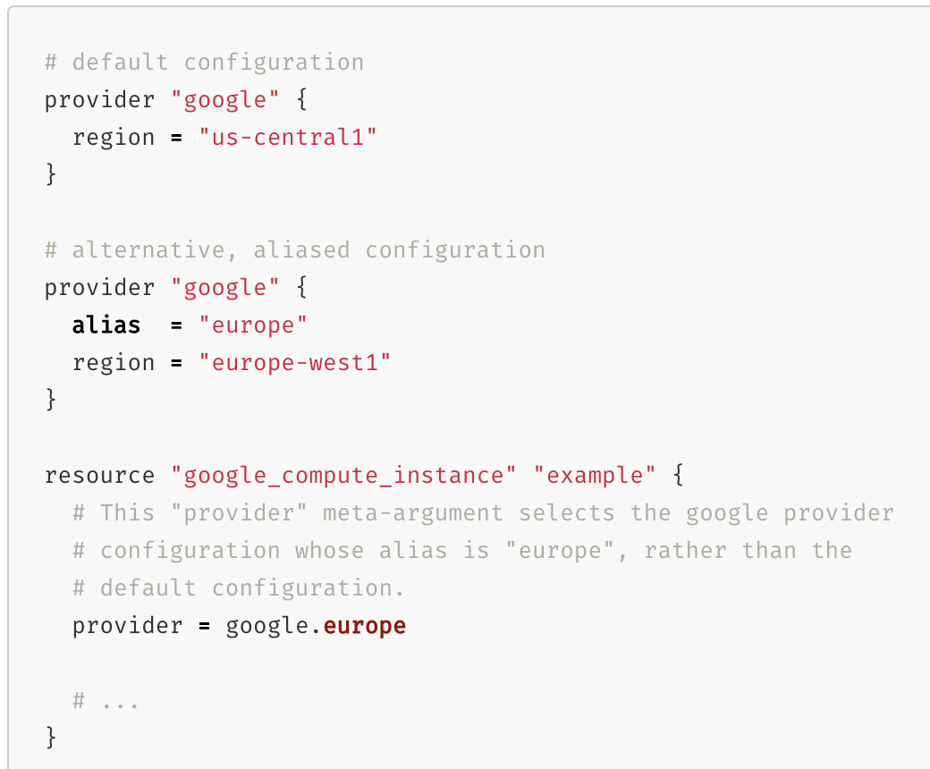
Terraform Meta-arguments
providers and provider are used when dealing with multiple providers in the same configuration

Slide 106
Backends
Backends are the concept that terraform uses to store state
Defaults to local tfstate file.
Others available:
S3
HTTP
Consul
Artifactory
Etcd
Terraform Cloud/Enterprise
etc...

Slide 107
Backends: S3
Because this course is about Terraform with AWS specifically, let’s talk about the S3 state backend:
Uses a bucket and path to an object (the state file) in the bucket for a central place to store state
Supports locking using an AWS Dynamo DB table
See https://www.terraform.io/docs/backends/types/s3.html for more info

Slide 108
Exercise 10: S3 Backends
Exercise 10

Slide 109
Exercise 11: Running an Application in AWS
Exercise 11

Slide 110
Terraform and Security
At resource level:
Follow best practices of your cloud provider
Use HTTPS/TLS
Don’t leave unused ports open
Encrypt EVERYTHING!
At code level:
Don’t pass secrets in plain text
Write modules for commonly used configurations
Use a static code scanner
Tag EVERYTHING!

Slide 111
Terraform Cloud/Enterprise
Platform for running Terraform jobs
Same platform, two different configurations:
Cloud
You write the Terraform code
You configure the runtime (Env vars, deploy conditions, etc.)
Hashicorp runs/manages the platform
Enterprise
You write the Terraform code
You configure the runtime (Env vars, deploy conditions, etc.)
You run/manage the platform

Slide 112
Terraform Cloud Terminology
Organizations – A private space where teams can share different infrastructure workspaces
Workspaces – A shared infrastructure space, has it’s own variables, state and configuration.
VCS Provider – An external code repository, I.E. GitHub, Bitbucket, Gitlab, etc...
Runs – One or more execution(s) of terraform plan, terraform apply
States – History of changes in Terraform state between runs

Slide 113
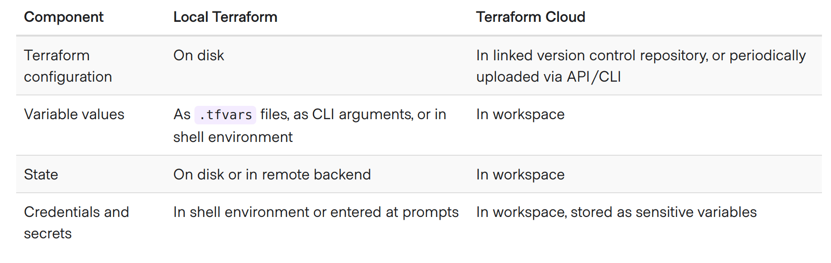
Terraform Cloud Terminology

Slide 114
Terraform Cloud Workflow Types
Version Control Workflow – Polls VCS for changes to repository, can configure branch, directory, approvals
CLI-driven Workflow – Link local files, state, run from Terraform Cloud backend
API-driven Workflow – Invoke Terraform Cloud APIs from other systems to start new runs (eg: Jenkins, GitHub actions, on-prem, etc)

Slide 115
Terraform Cloud/Enterprise Advantages
Central point of control for infra
Private Module Repository
Cost Estimation
Graphical view of infra changes
Audit Logging (Enterprise)
SAML SSO (Enterprise)

Slide 116
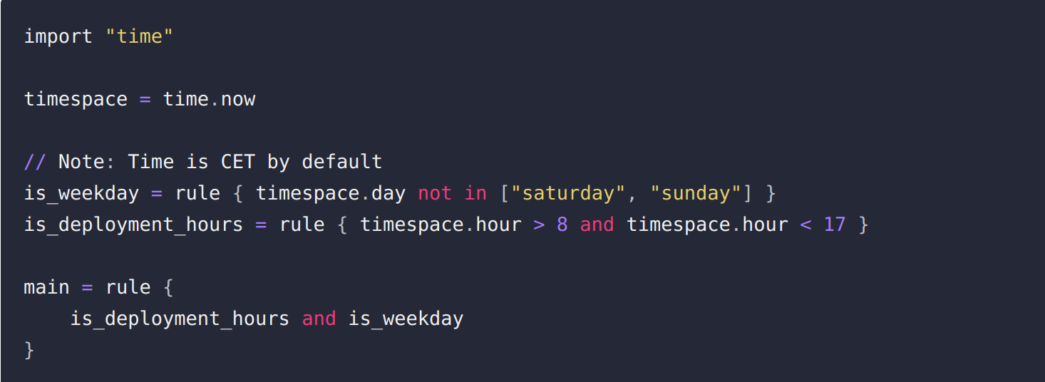
Sentinel
Policy-as-code framework for Terraform Cloud/Enterprise
Write assertions for Terraform runs
Notes:
Sentinel checks between Plan and Apply steps in terraform cloud
Stops run from being applied unless user with sufficient privileges overrides it

Slide 117
Sentinel Imports
tfplan – Gives access to Terraform plan in the current run
tfconfig – Gives access to *.tf files in the current run
tfstate – Gives access to the Terraform state of the workspace and current run
tfrun – Gives access to the workspace and cost estimate data of current run

Slide 118
Experimentation Time
Let’s discuss some idea for experiments
You should be just about armed with all the knowledge you need to explore any part of Terraform you like, groups encouraged!
What would be most useful to your actual work?

Slide 119
Experimentation Time–Some Ideas
How could you use Terraform from a server that has no internet access?
terraform import, terraform graph
tfenv for managing versions of the terraform binary
Look at the student-environments terraform code in the repo. This is how I set up all of your student accounts/aliases in AWS in prep for this course. Can you identify ways that could be used to improve this terraform?
Terraform gotchas: https://blog.gruntwork.io/terraform-tips-tricks-loops-if-statements-and-gotchas-f739bbae55f9 and https://heap.io/blog/engineering/terraform-gotchas

Slide 120
What should I do now?
Get in touch at any time: chris@devbyaccident.com
Take what you’ve learned, experiment, and then experiment some more!
Get involved in the Terraform community
Follow releases, Github issues, etc.
It’s the best way to stay up on the current state of affairs!

Slide 121




Thank you!
Notes:
Mandatory -- Need bookend -- first and last thing they should see is DevelopIntelligence
ACTION: Use this for the final slide of your class materials. Include contact information so participants can reach you if they have questions after the course.

